Slide 1
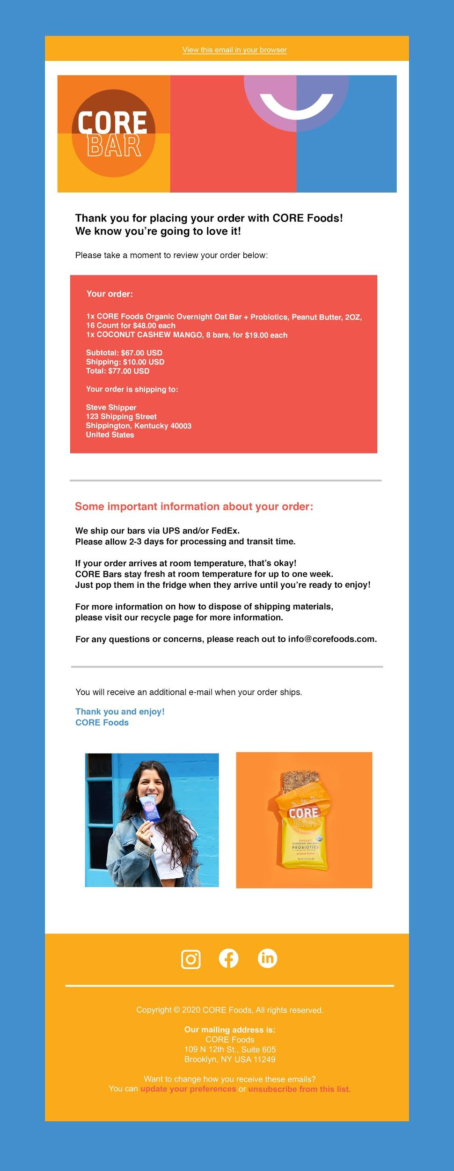
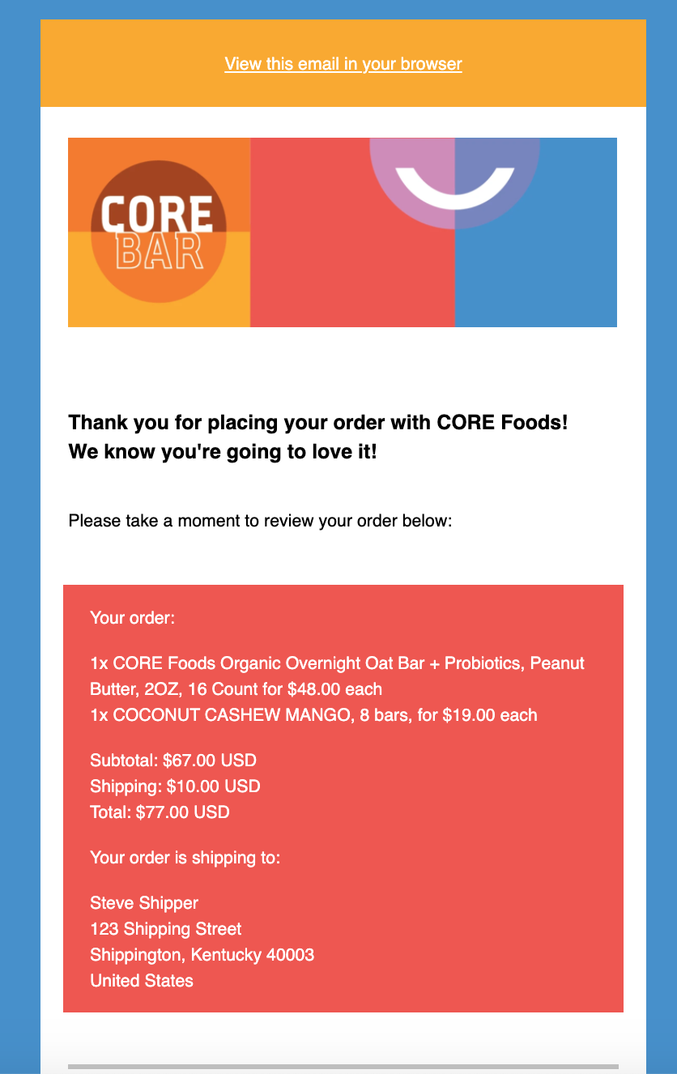
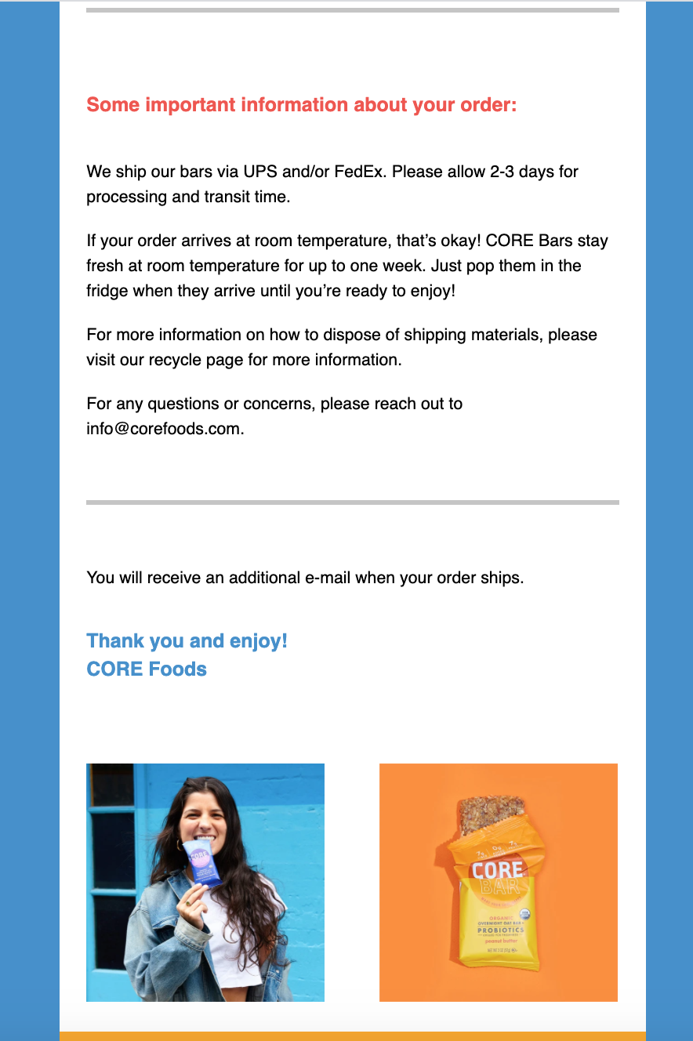
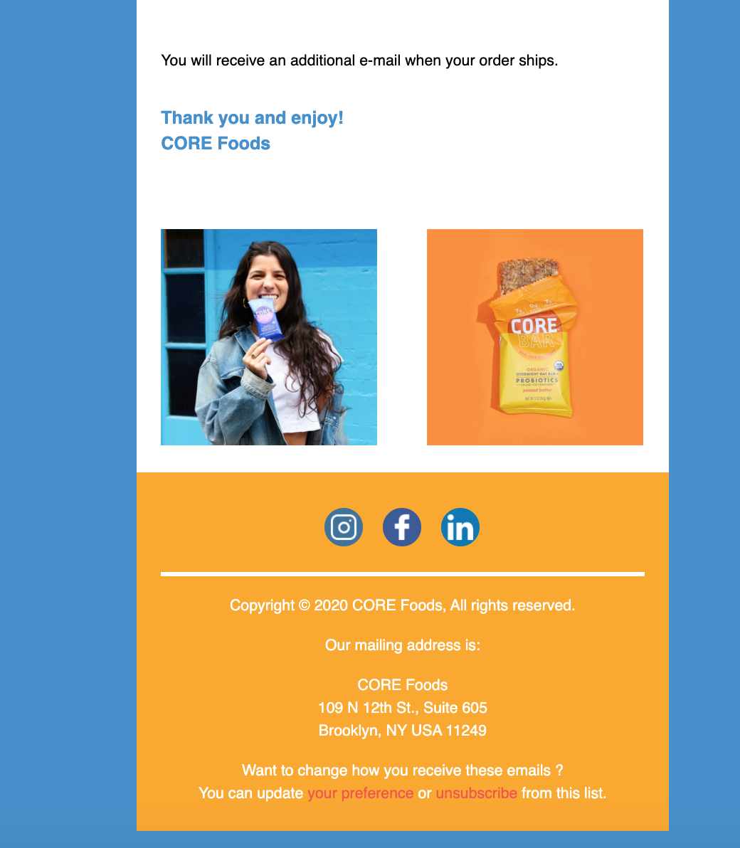
Order Confirmation
Reduce the size of this box
Reduce the whitespace to match
Check font size & spacing- looks tighter on their version
Should this be bold?
Check font size
Make all icons white
Check spacing- looks tighter on their version

Slide 2
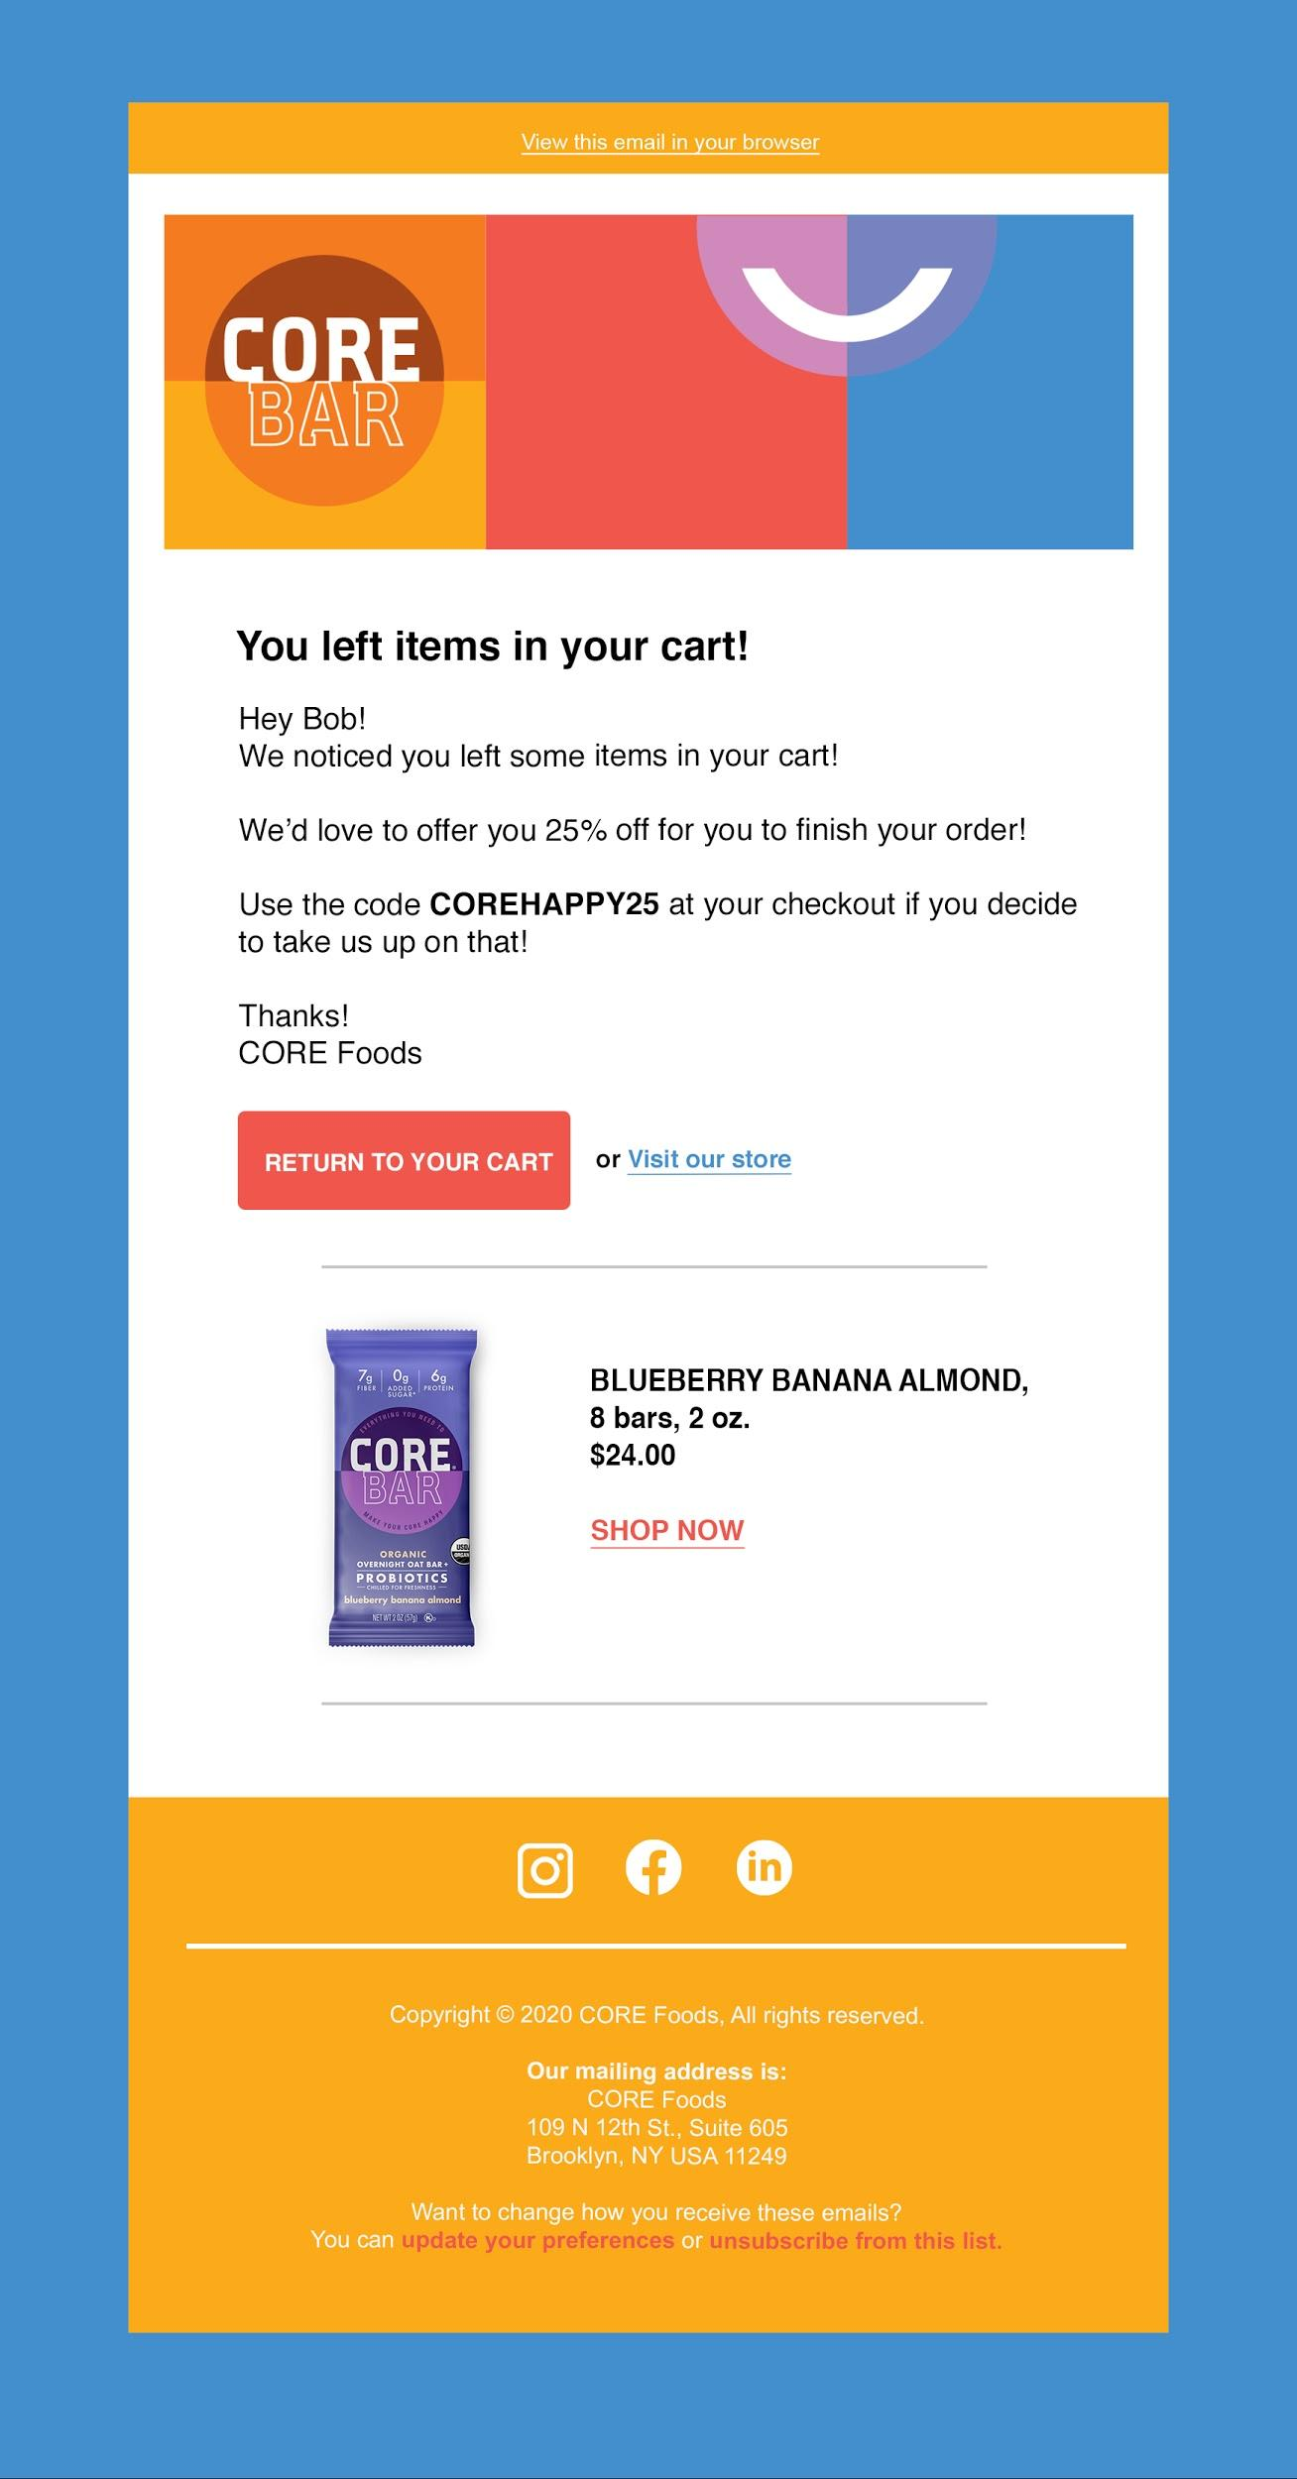
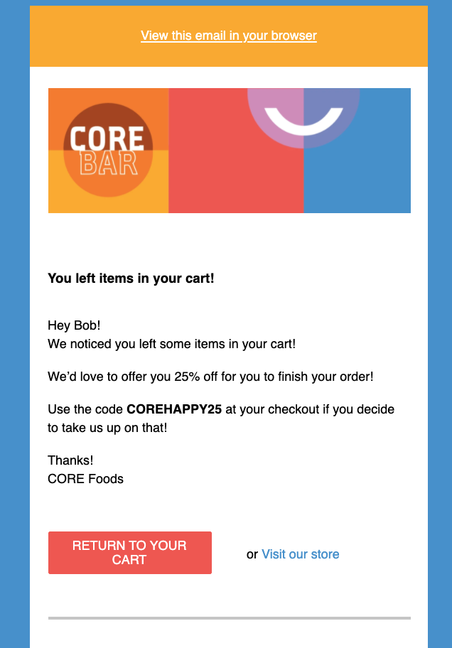
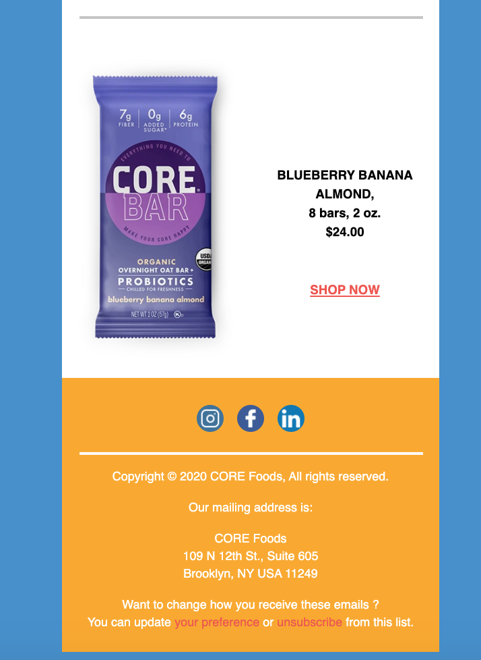
Abandon Cart
Reduce the size of this box
Reduce the whitespace to match
Button should be on 1 line, the Visit Our Store should be more to the left
Bar should be smaller.
Font should be Left Aligned
Shop Now shold be left aligned
Make all icons white
Check spacing- looks tighter on their version

Slide 3
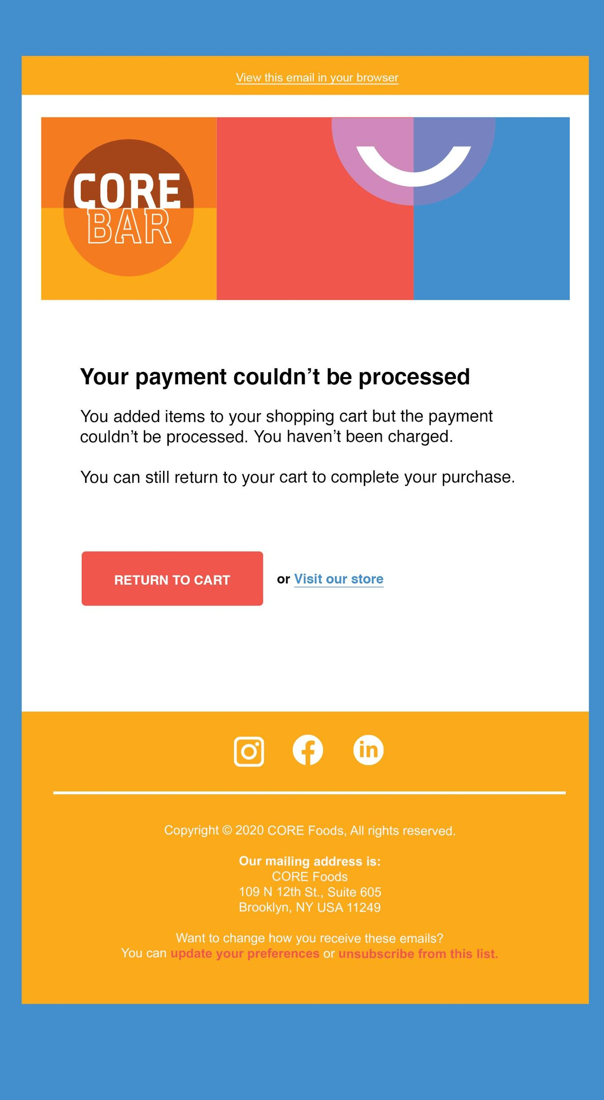
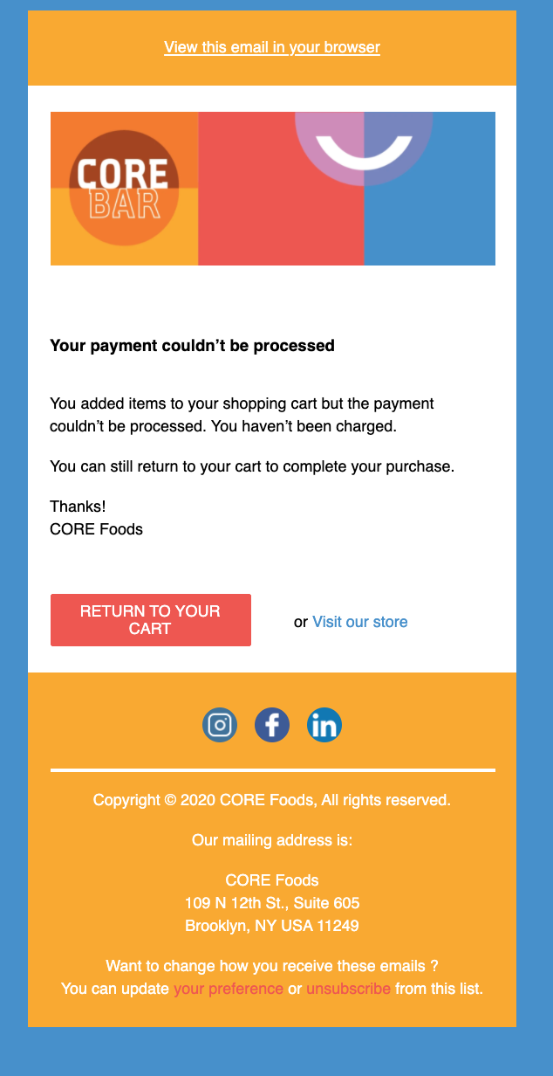
Payment Procesed
Reduce the size of this box
Reduce the whitespace to match
v
Was this text on her psd? Not on the jpg she sent
Font size on the button should be smaller to be all on 1 line
The spacing on Visit our store needs to match
Make all social icons white
Check spacing- looks tighter on their version

Slide 4
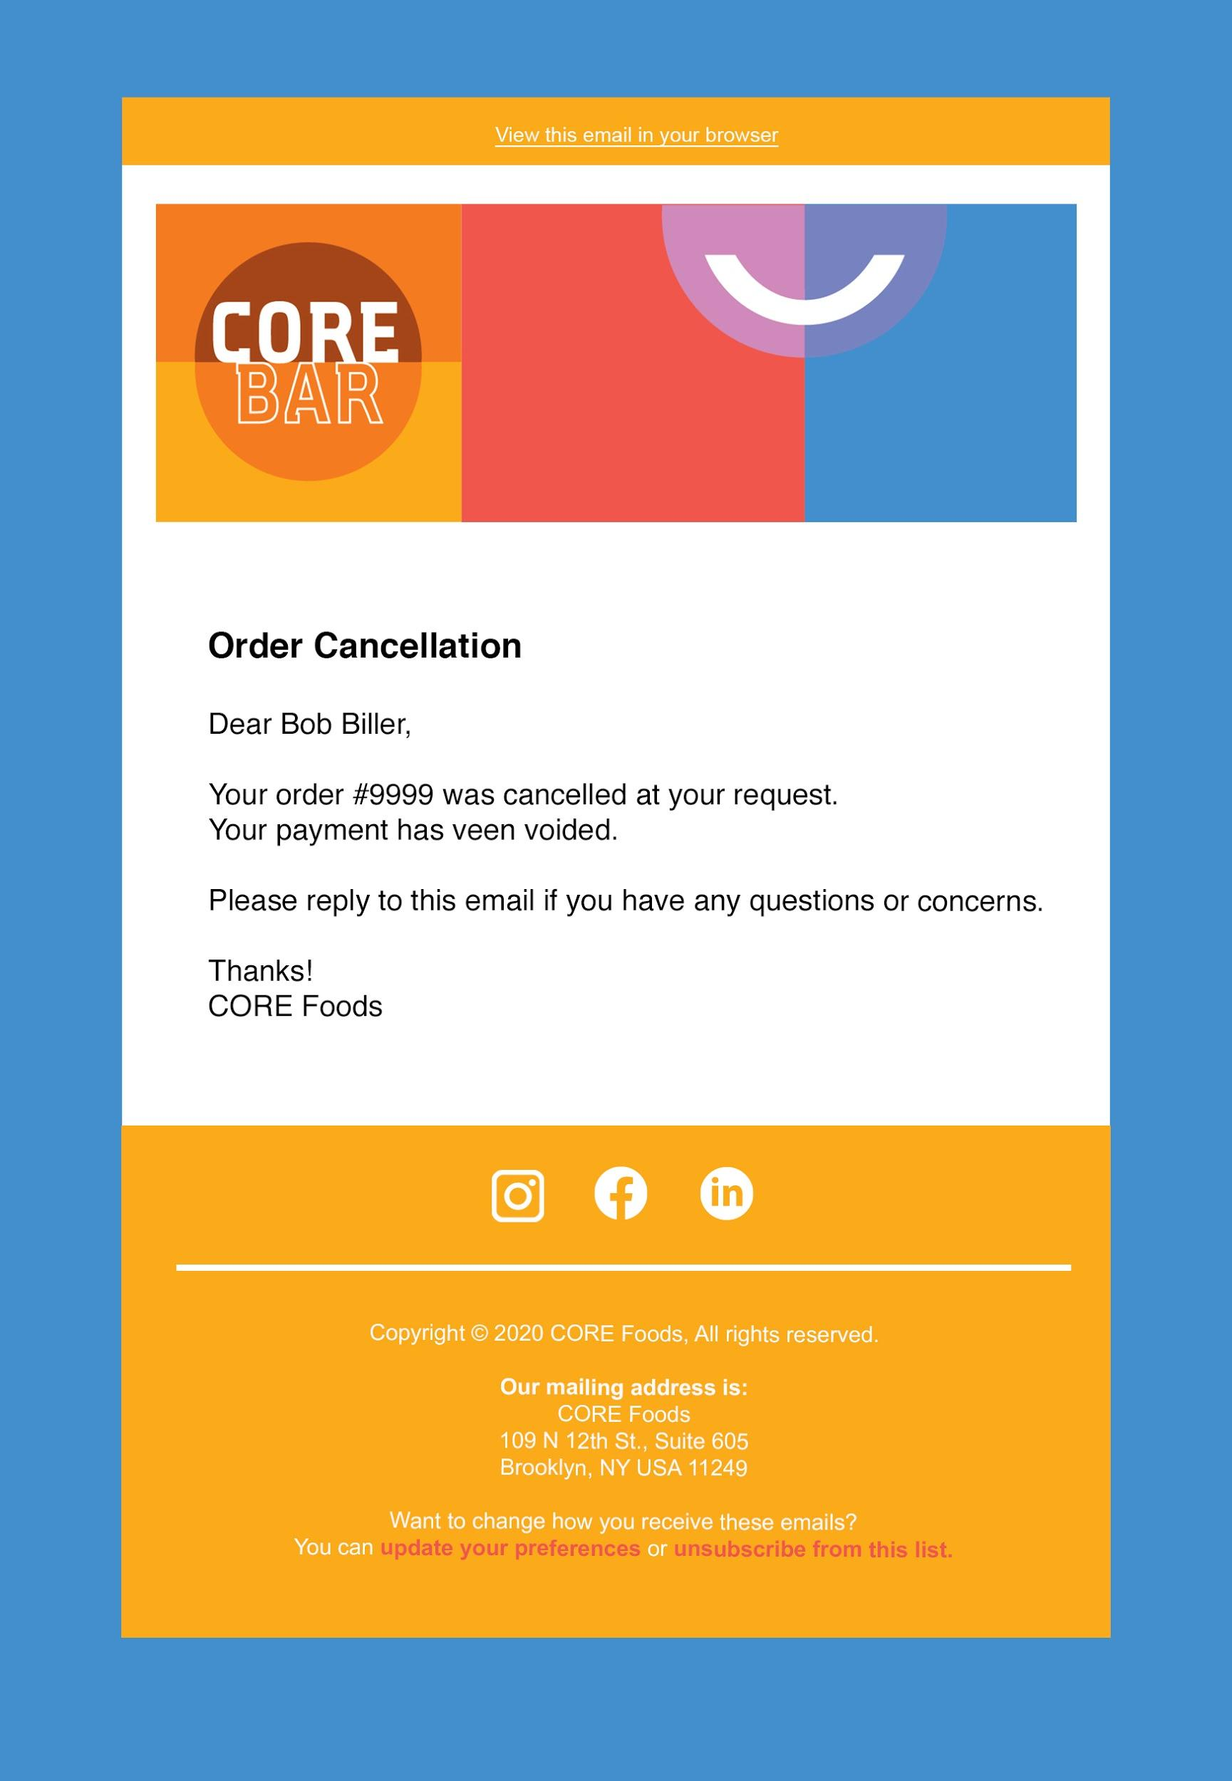
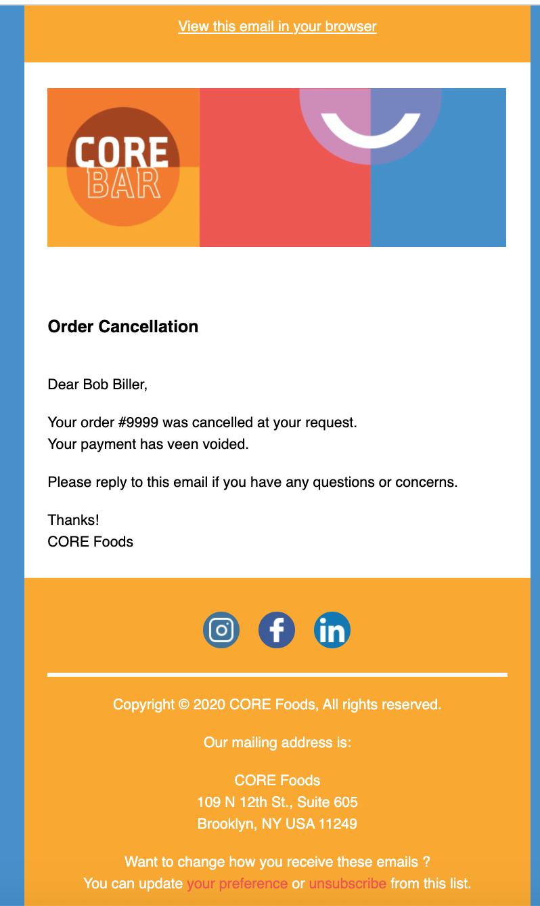
Order Cancelled
Reduce the size of this box
Reduce the whitespace to match
Make all icons white
Check spacing- looks tighter on their version

